Slide 1

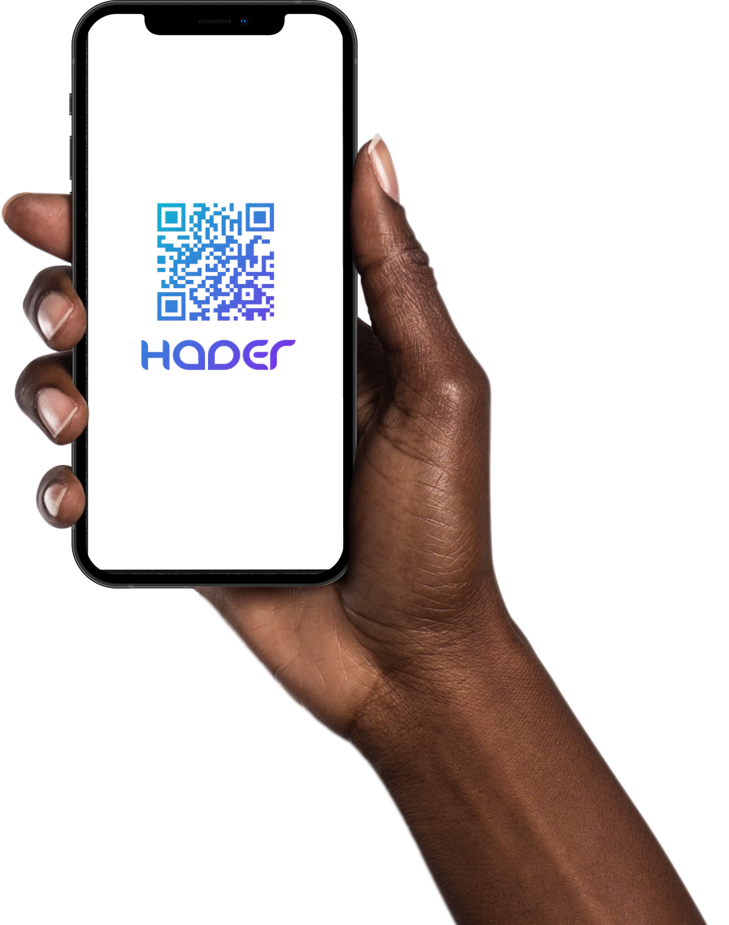
HADER
Senior Project Presentation
Presented by:
(Leader) Shahad AlTamimi - 2170001466
Lamia AlHammad – 2180001345
Deemah AlRushood - 2180000066
Danah AlDosari - 2180005949
Project Supervisor:
Ms. Asiya Abdus Salam
Project Evaluators:
Dr. Rami Mohammad – Ms. Elham Shafoult
Notes:
Design issues
Benefits of qr
Security (encrypted passwords)
Ux design, usability
Waterfall vs agile.. Etc
Business perspictive, why hader?

Slide 2
Agenda
Introduction
Objectives
Technological Impact
Testing
Data Management
Challenges And Difficulties
Lessons & Skills Learned
Overview Of The demo
Demo
Conclusion & Acknowledgement
2
Notes:
Ask questions

Slide 3
Introduction
01
3
Lamia

Slide 4
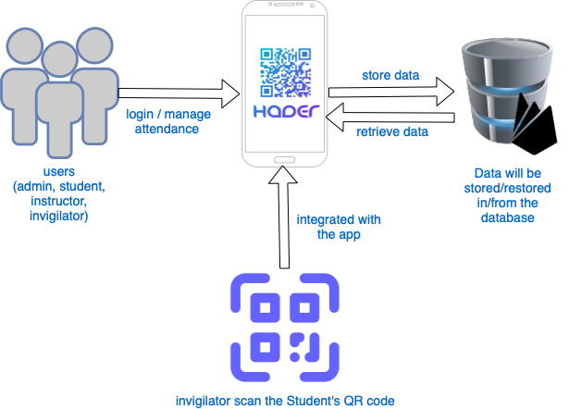
Architecture Design
Lamia
Notes:
As u can see in this arch diagram
, hader serves 4 types of users admin instructor invigilator and ofcourse students.
They all use the same medium which is the mobile wether its ios or android
All data are registeres in the firebase database securly

Slide 5
02
Objectives
5
Lamia

Slide 6
Aims & Objectives
Facilitate and secure the attendance process.
Reduce the amount of noise in the exam room.
Utilizing modern technology at the IAU, CCSIT division.
Integrate everything related to exams in one platform.
Facilitate the process of submitting and responding to excuses.
Assisting CCSIT's Academic Affairs Unit by automating the registration of student attendance data during exams.
6
Lamia

Slide 7
03
Technological Impact
7
Shahad

Slide 8
The technological impact of HADER
HADER is in line with the Kingdom of Saudi Arabia's 2030 vision for digital transformation.
HADER is changing the way of taking exam attendance and management.
HADER can reduce time and error and provide solutions for organizations and individuals.
Shahad
Notes:
As mentioned by the team, HADER can reduce time and error and provide solutions for organizations and individuals

Slide 9
Testing
03
Shahad
Notes:
Gray Box Testing :
Gray Box Testing is a combination of the Black Box Testing technique and the White Box Testing technique in software testing. The gray-box testing involves inputs and outputs of a program for the testing purpose but test design is tested by using the information about the code. Gray-box testing is well suited for web application testing because it factors in a high-level design environment and the inter-operability conditions.
White Box Testing :
White-box testing or glass-box testing is a software testing technique that tests the software by using the knowledge of internal data structures, physical logic flow, and architecture at the level of source code. This testing works by looking at testing from the developer’s point of view. This testing is also known as glass box testing, clear box testing, structural testing, or non-functional testing.
Black Box Testing :
Black box testing is a type of software testing in which the functionality of the software is not known. The testing is done without the internal knowledge of the products. It is also called Functional testing. Black-box testing focuses on software’s external attributes and behaviour. This type of testing looks at an application’s software expected behaviour from the user’s point of view.

Slide 10
Testing
TESTS | PURPOSE
Gray box testing | Testing involves inputs and outputs for the testing purpose.
Integration Testing | The integration test will be performed following the grouping of unit-tested units to ensure that the design objectives, system performance, and functional requirements are met.
Interface Testing | to verify that the connection of various component systems is done efficiently and effectively.
Shahad
Notes:
Grey Testing is known as that it is a combination of the Black Box Testing technique and the White Box Testing technique in software. We implemented grey box to see if there are any defects this is implemented in the security testing as well that I will explain in the next slide
Integration testing is where we actually grooooup our unit so the become integrated and then we test those unit test together.
Interface testing is where we want to verify the connection between various components and validate that it is done efficiently and effectively

Slide 11
TESTS | PURPOSE
Security Testing | To identify and eliminate any potential points of system failures. gray-box testing will be used to locate all potential defects in the software. The measures of confidentiality, integrity, authentication, authorization, availability, and security.
Performance Testing | Users expect a response time of less than 15 seconds, and testing should make sure that it is available round-the-clock and in a variety of settings.
Acceptance Testing | To test the system before it is delivered to application users The system will be used by the user to ensure that the system meets the acceptance criteria for the system under consideration.
Shahad
Notes:
Performance testing is To validate that the system perforrrrms in accordance with ((user expectations)) and that the application's performance should remain constant meaning that it shows the same result as.

Slide 12
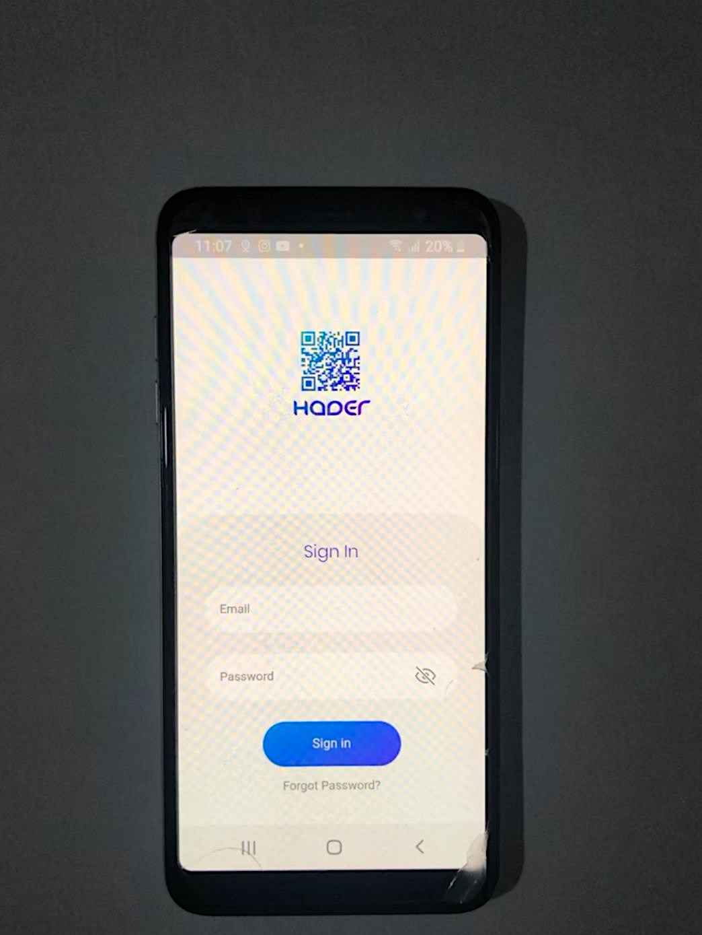
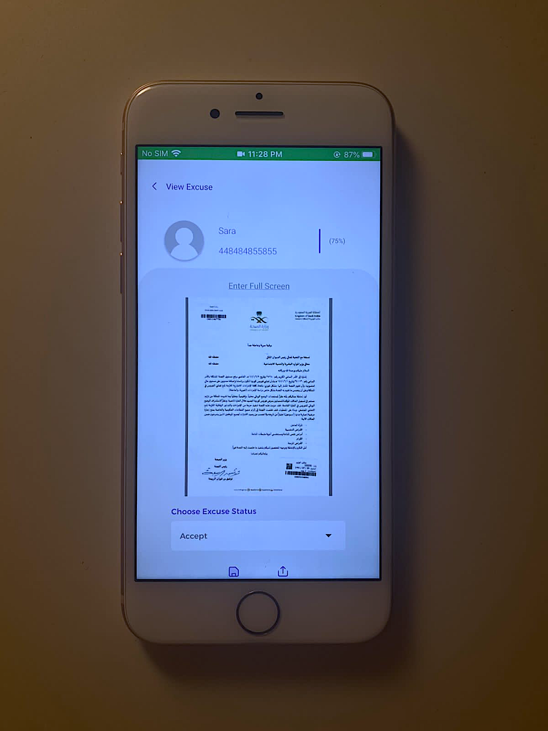
HADER app on Android
HADER app on iOS
Shahad
Notes:
This is the app and it is running on android As will ios

Slide 13
04
Data Management
13
Danah

Slide 14

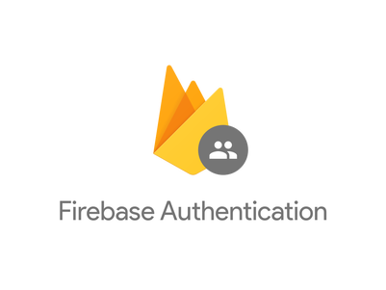


Danah

Slide 15
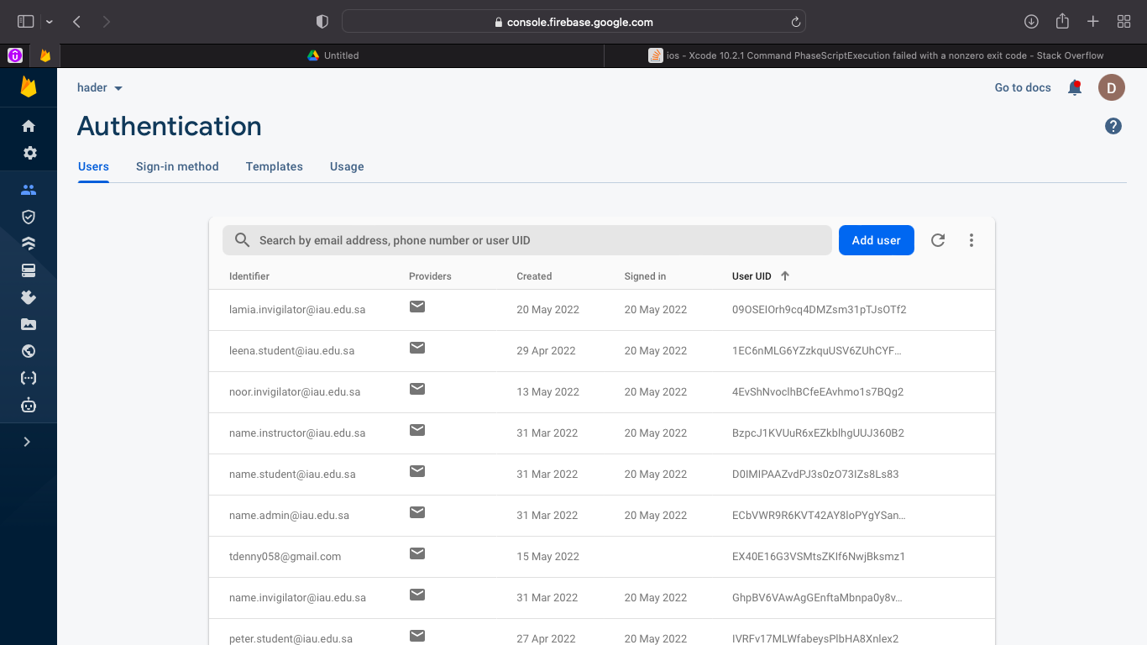
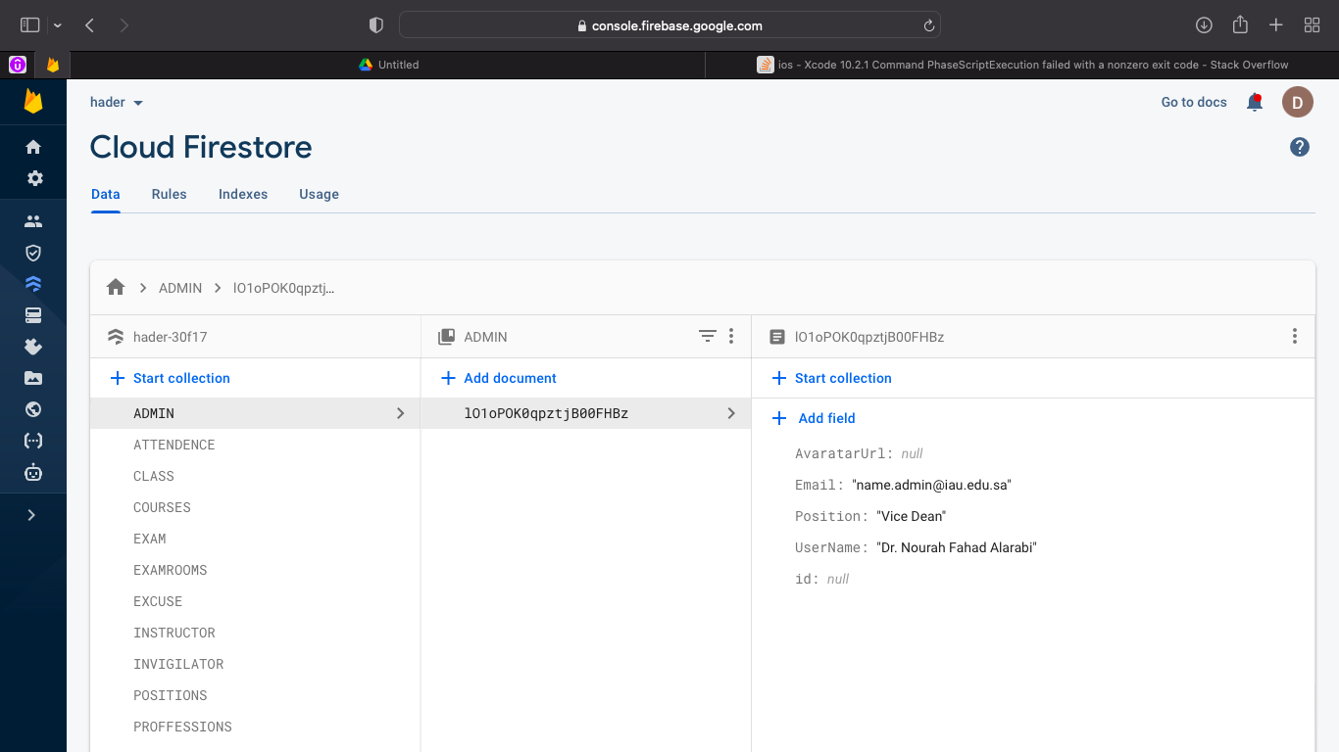
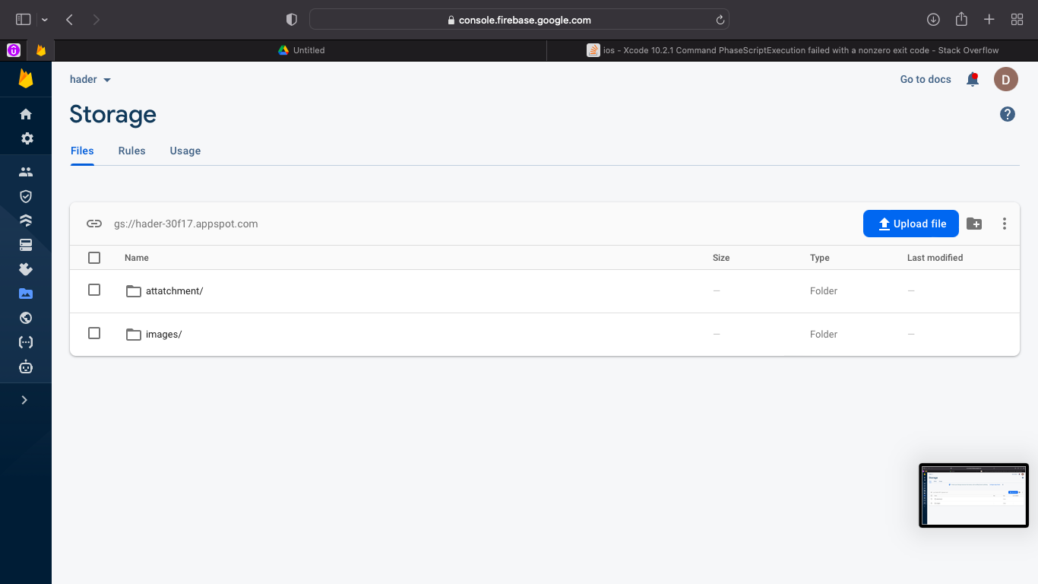
Danah

Slide 16
05
Challenges And Difficulties
Deemah

Slide 17
Challenges And Difficulties
Collecting the code from every member
Errors and finding solutions
01
02
03
04
Updating and downloading software packages
Absence of a team member and change management
Deemah
Notes:
We have faced a lot of challenges and difficulties, main challenges are
First Collect the code from every member
Updating and downloading software packages
Updating and downloading software packages
And Absence of a team member and change management

Slide 18
06
Lessons & Skills Learned
Deemah

Slide 19
Lessons & Skills Learned
Benefit from the literature reviews collected in different authentication methods along with their different accuracy results to utilize and implement them.
Understanding of project risks, time, and resources required to complete the project.
Utilize the available resources.
Identify priorities and determine future work direction.
How to deal with change management during the implementation phase.
Debugging errors and finding solutions.
Building an application and considering business relevance.
Deemah
Notes:
We have had the opportunity to learn lessons and gain skills some of them
Benefit from the literature reviews collected in different authentication methods along with their different accuracy results to utilize and implement them.
like New technologies, approaches, and techniques.
Understanding of project risks, time, and resources required to complete the project.
Utilize the available resources.
Identify priorities and determine future work direction.
How to deal with change management during the implementation phase.
Debugging errors and finding solutions.
Last point: Building an application and considering business relevance. Implementing
ethical, social, and legal implications that are flexible enough to meet any business.

Slide 20
Overview Of The Demo
07
20
Danah

Slide 21
System Features
Common
Login
Logout
Forgot password
Admin
Manage Students Excuses
Show the Students Absent Percentages
Invigilator management
Admin Profile
Instructors
Show instructor’s information
Instructor Receive notification
Invigilators
QR Scanner to Scan Students QR Codes to Check-in
Show Invigilator Information
Edit, add or delete the student’s attendance status
Send Attendance Reports Via Email
Show Student’s Names List
Students
Display QR Code: to be scanned by the exam invigilator.
Show Student Information
Upload exam excuse
View exam excuse status
Danah
Notes:
Admin (add invigilator) – Invigilator (scans the student & shares the list) – instructor (receives the notification) – student (absent) – admin - student

Slide 22
Demo
08
Notes:
Admin – Invigilator (scans the student) – instructor – student – admin - student

Slide 23
Conclusion & Acknowledgment
09
Lamia
Notes:
To summarize, Exam attendance is one of the tasks that should be automated in CCSIT. The traditional way of taking exam attendance is inefficient, takes a lot of time, disrupts exam rooms, and isn't very accurate. Students at CCSIT can use HADER to make sure that they show up for their exams on time. It lets the academic affairs unit manage attendance and exams, and it makes it easy for invigilators to scan students' QR codes and automatically record their attendance in the academic affairs unit's databases. Students can also send in their excuses, which will be approved or not by the Academic Affairs Unit. Finally, the application will be built with high security, and high authentication techniques to verify and validate the whole attendance process.
Recommendations for future work
1. Create a desktop version of the system for all users.
2. Integrate solution into IAU database for all IAU colleges and facilities.
3. Allow the admin to take invigilator attendance to ensure they arrive on time.
4. Validating if the student is in the correct exam hall.
5. Enable location access and GPS to notify students and invigilators that your exam is in this hall if they pass by.

Slide 24
Conclusion
Exam attendance should be automated in CCSIT.
HADER Allows the academic affairs unit manage attendance and exams.
Enables invigilators to scan students’ QR codes.
Enables students to send excuses
The application is built with high security.
24
Lamia
Notes:
As you saw, hader ia an application designed and programmed with the highest professionalism and quality, all ids and passwords are encrypted in the database. It is charachtarized by its easy to use interfaces for all users.
We believe that the use of hader application in the college of computer will make the process of taking attendance easier, faster and more secure as it serves all parties in this process, si its an application that includes everything related to taking attendance in exams.
It was accepted in moshaat boot camp and the paper is successfully published on ijet, and we plan to publish more inshaalah

Slide 25

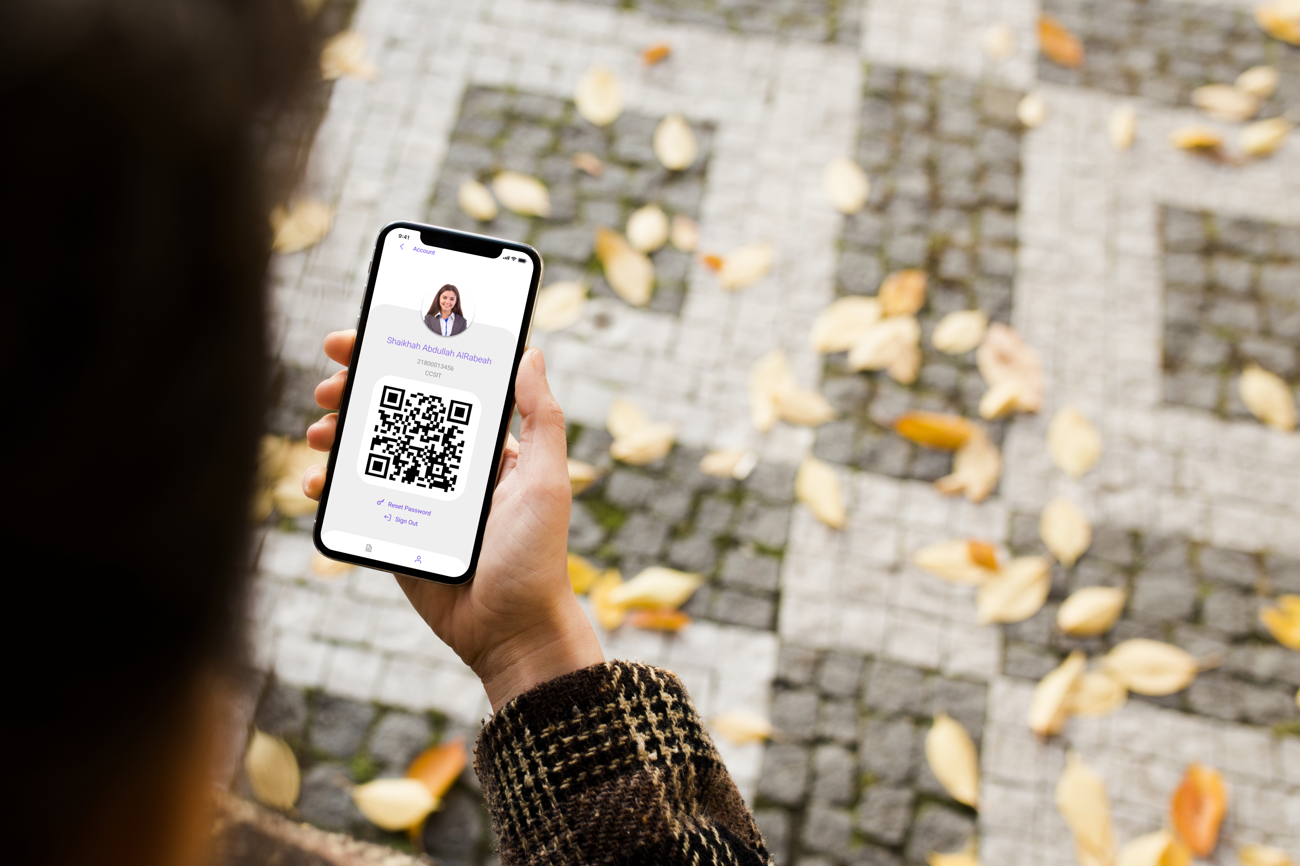
Thank You! Any Questions?

